Slide 1

Quick Reference Card Message Flow between Record Types in ServiceNow
Owner: Customer Service Transformation (Franchise for Cloud Excellence – GPSO – IEG)
December, 2019

Slide 2
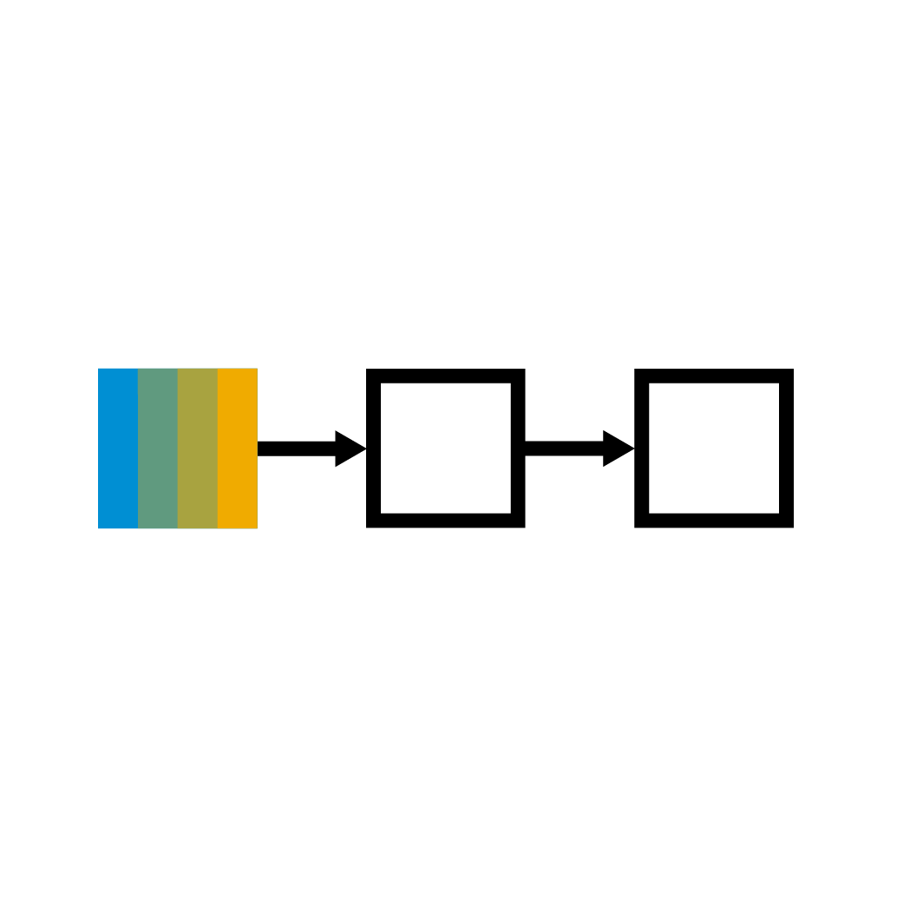
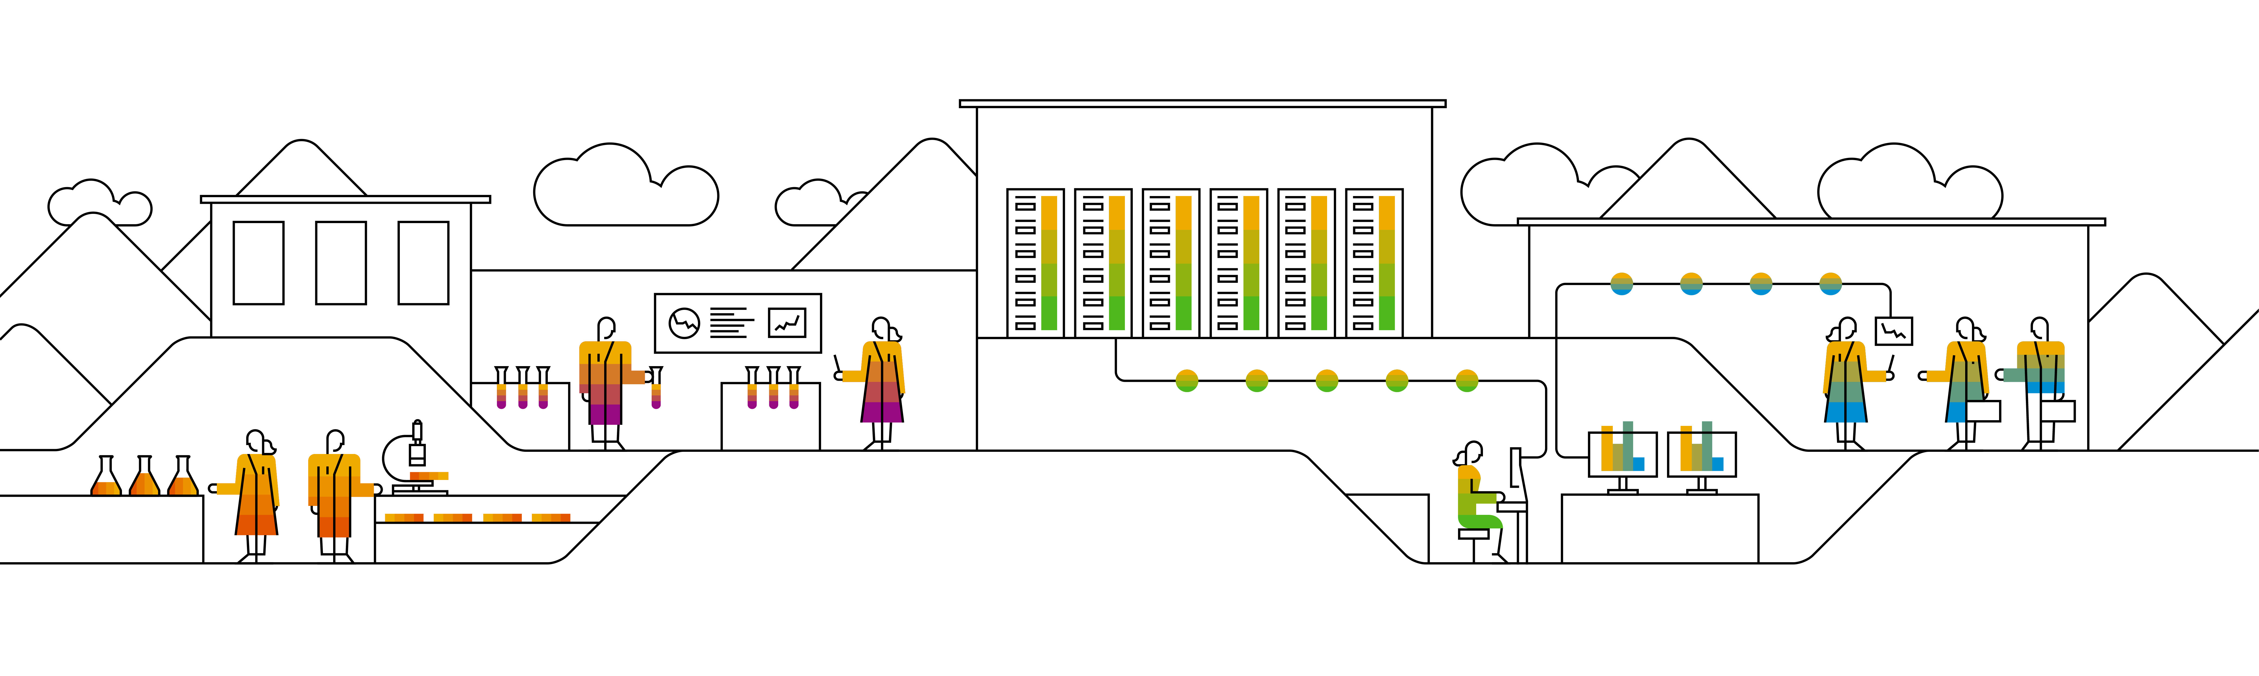

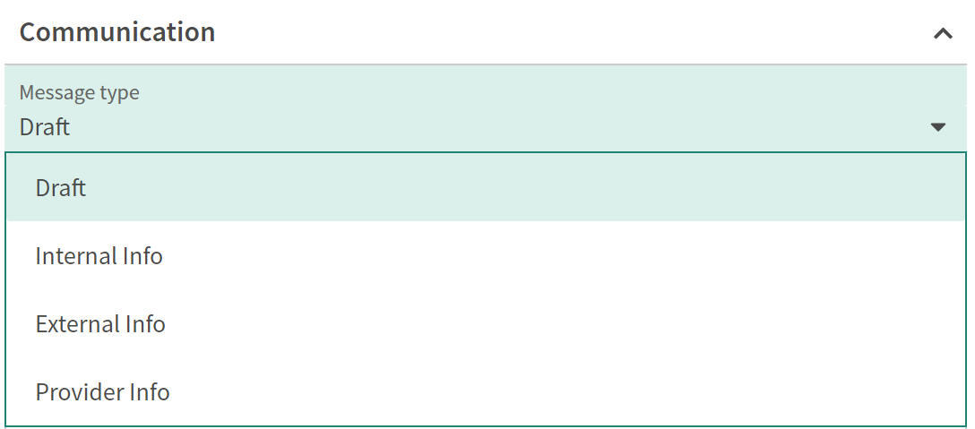



HCSM Message Flow between Record Types in ServiceNow
Description
Process / Explanation
Description
This document explains the message flow between the resolution providing and the resolution receiving record types via the External/Provider Info communication.
Draft messages are stored in the respective record field pending a type selection
Internal Info messages are stored (in the activity log) in the record and visible only to the users viewing that record
Audience
External Info messages are stored (in the activity log) in the record itself & depending on the record type sent to the requestor/customer
Support, Development and Operations
Prerequisites
Provider Info messages are stored (in the activity log) in the record itself & depending on the record type sent to the provider (3rd party, SAP partners)
Not applicable
What happens if I select External Info for communication?
Overview
Resolution providing NOW Record
Logging an External Info
Appears as Internal Info
Resolution receiving NOW Record
Context
To communicate via the ServiceNow message system inside the different records you can select Draft, Internal Info, External Info or Provider Info. Depending on the record you are working on different behavior is triggered while selecting External Info/Provider info. If you select Draft or Internal Info messages, these messages always stay within the same record.
Way back by jumping to the providing Record directly or via link of the Internal Info
Record | Relationship | Record
Incident | N : 1 | Case
Problem | 1 : 1 | Case
Problem | 1 : 1 | Incident
Selected scenarios
…
For more scenarios see next slide

Slide 3
HCSM Message Flow between Record Types in ServiceNow – All Scenarios
Resolution providing NOW Record
Logging an External Info
Appears as Internal Info
Resolution receiving NOW Record
Resolution providing Record
Logging an External Info
Resolution receiving customer
Way back by jumping to the providing Record directly or via link of the Internal Info
Appears as SAP comment
Record | Relationship | Record
Incident | N : 1 | Case
Problem | 1 : 1 | Case
Major Case | 1 : N | Case
Major Incident | 1 : 1 | Case
Incident | N :1 | Major Case
Problem | 1 : 1 | Major Case
Major Incident | 1 : 1 | Major Case
Incident | N : 1 | Incident
Problem | 1 : 1 | Incident
Major Incident | 1 : N | Incident
Incident | N : 1 | Major Incident
Problem | 1 : 1 | Major Incident
Record | Relationship | Customer
Case | 1 : 1 | XYZ
External Info out of a Case always goes to the customer
Reasoning: The designed relationship between the records has been decided to support the processes and the ITIL logic. 1 external issue results in 1 Case. 1 internal issue results in 1 Incident. 1 Incident can only be related to 1 sustainable resolution via 1 Problem.

